Slide 1



Hardware and Software Fundamentals of Intelligent Computing Systems

Slide 2
Lecture 17: Architectural Design of Operator Libraries

Slide 3
Outline
Principles
Dispatcher
DSL
Case Study

Slide 4
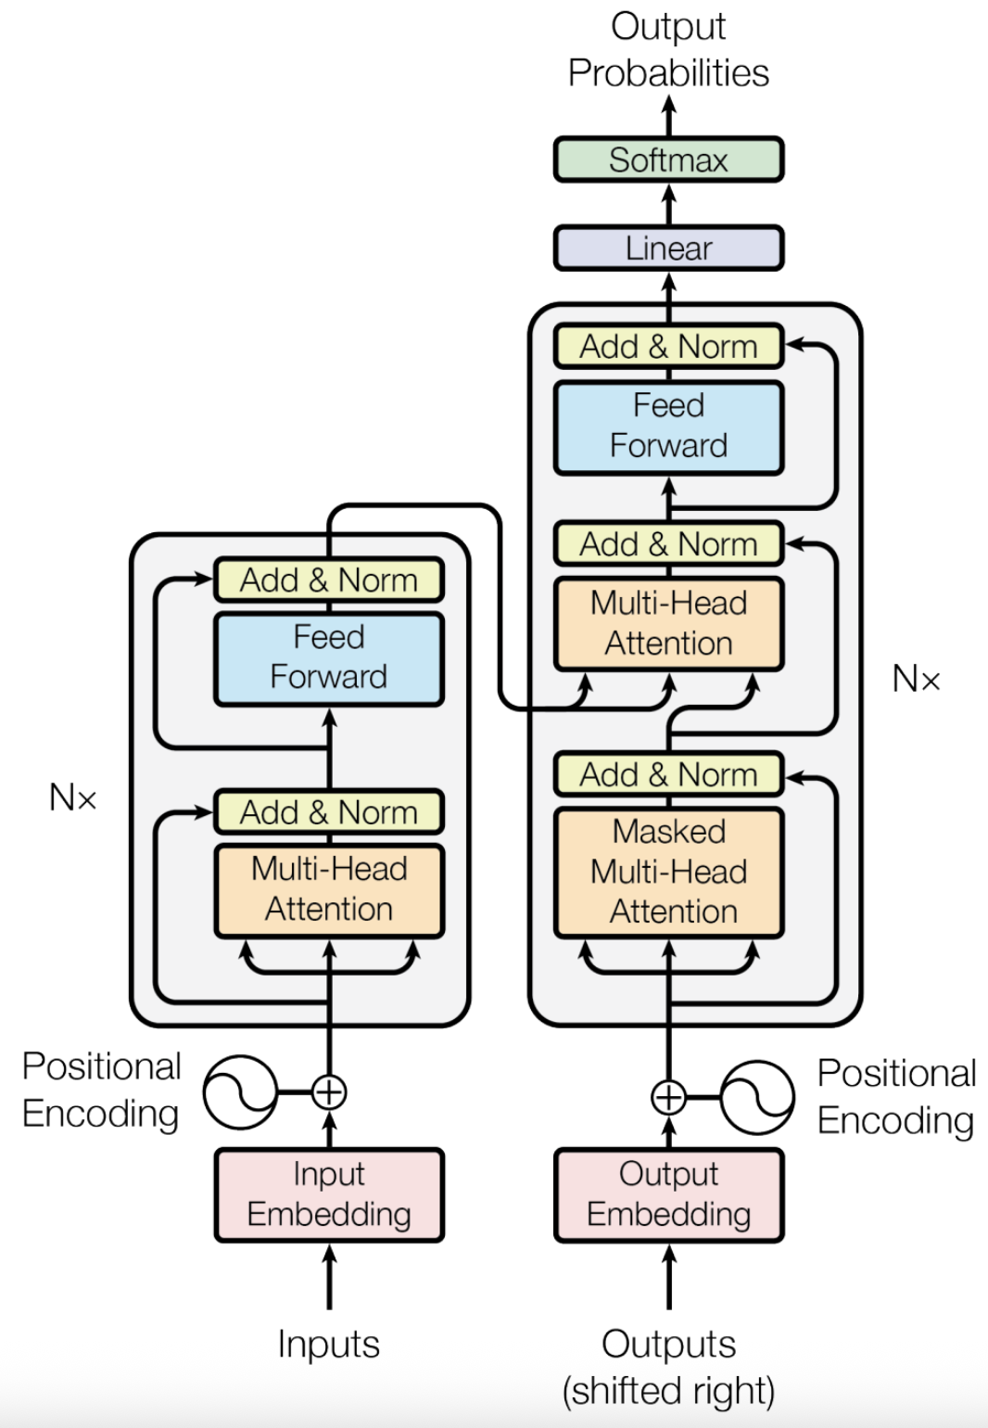
Operator
Broadly speaking, applying any specific operation to a given function can be defined as an Operator.
Deep learning algorithms are constructed from individual computational units known as Operators.
Examples: Add, MatMul, LayerNorm

Slide 5
Operator Library
Deep Learning Framework
A collection of highly optimized, reusable computational building blocks (Operators) for neural networks.
Core Roles:
The Bridge - Connects high-level AI frameworks with low-level bare-metal hardware.
Performance Extractor - Maximizes hardware utilization via expert-level kernel tuning.
Hardware Abstraction - Shields algorithm developers from complex low-level programming.
Operator Library
Compiler
Hardware

Slide 6
Design Principles - Usability
Seamless Integration with High-Level Frameworks
Register the operator library directly into the framework's internal dispatch mechanism to allow existing models to benefit from acceleration with zero code modifications.
Automatic Hardware Discovery
Implement runtime detection of the execution environment to automatically load the optimal backend without requiring manual user configuration.
Uniform Interface for Diverse Backends
Define a standardized abstraction layer so that the same high-level API remains consistent across a wide variety of hardware architectures
Multi-Level Abstraction Architecture
Offer a tiered abstraction system to meet diverse needs: high-level for rapid prototyping, mid-level for tuning parallelism and tiling, and low-level for expert optimization of hardware specifics like registers and warps
https://github.com/flagos-ai/FlagGems
Notes:
https://github.com/flagos-ai/FlagGems

Slide 7
Design Principles - Performance
Persistent Caching and Pre-Tuning
Store optimized computational configurations and pre-warm kernels to eliminate initialization delays and ensure peak performance from the very first execution.
Hardware-Aware Configuration Mapping
Utilize a configuration system that abstracts hardware-specific constraints, such as memory hierarchy and compute unit limits, into the code generation process.
Adaptive Tiling
Decomposes operators into optimal compute tiles based on input dimensions, minimizing padding overhead and maximizing memory bandwidth utilization across variable sequence lengths.
https://github.com/flagos-ai/FlagGems
Notes:
https://github.com/flagos-ai/FlagGems

Slide 8
Trade-off
Dynamic Shape vs. Hardware Alignment
Arbitrary input sizes often limit hardware-aligned peak performance
Solution: Adaptive Tiling
Intuitive Layout vs. Optimal Memory Access
Standard data formats often conflict with hardware-optimized memory patterns
Solution: Layout Transformation
Black-box API vs. Fine-grained Tuning
Simplified interfaces hide the tuning knobs needed for expert optimization
Solution: Heuristic Mapping
A dispatch mechanism is required to manage these automated solutions and bridge the gap between user intent and hardware execution.

Slide 9
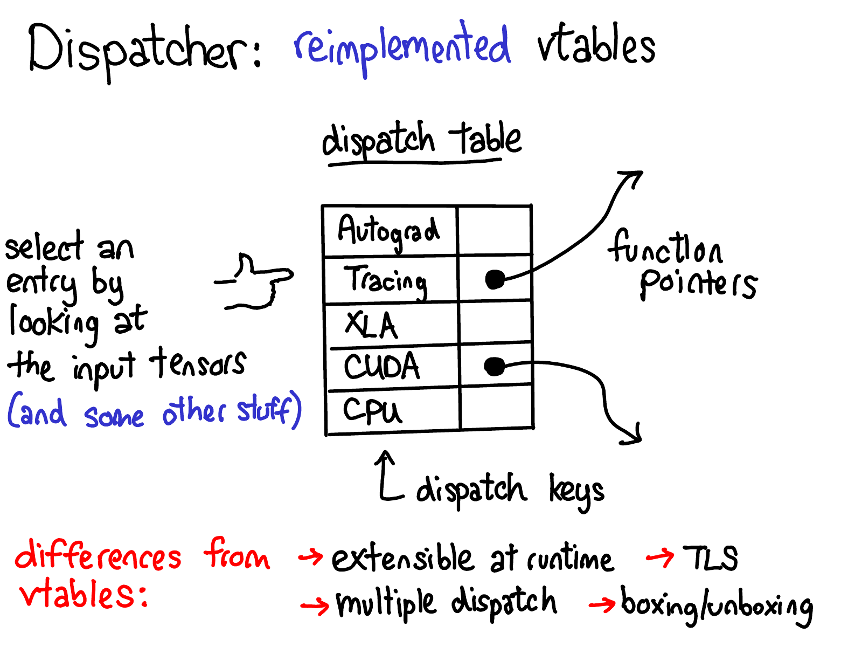
Dispatcher
A dispatcher is a component that routes an operation to the appropriate implementation or backend based on runtime criteria such as device type, data properties, or configuration policies.
https://blog.ezyang.com/2020/09/lets-talk-about-the-pytorch-dispatcher/

Slide 10
Simplified Dispatch Workflow
1. Metadata Collection
Extract metadata such as device, data type, and layout from input tensors
2. Key Computation
Combine multiple attributes to generate a unique Dispatch Key
3. Table Lookup
Search the global Dispatch Table for the corresponding kernel function pointer
4. Execution
Invoke the specific backend implementation to perform the computation
https://blog.ezyang.com/2020/09/lets-talk-about-the-pytorch-dispatcher/

Slide 11
Advanced Dispatching Mechanisms
Sequential Re-dispatching
A single operator call can trigger a chain of handlers by masking processed keys and re-invoking the dispatcher to find the next implementation.
Heuristic Implementation Selection
Profile workload metrics (e.g., shapes) and hardware attributes (e.g., SM counts) to adaptively select optimal algorithm paths and execution parameters.
Dynamic Kernel Instantiation
Specialized kernels can be generated and cached on-the-fly to handle various task dimensions or broadcasting patterns without manual coding.
https://blog.ezyang.com/2020/09/lets-talk-about-the-pytorch-dispatcher/
https://github.com/flagos-ai/FlagGems

Slide 12
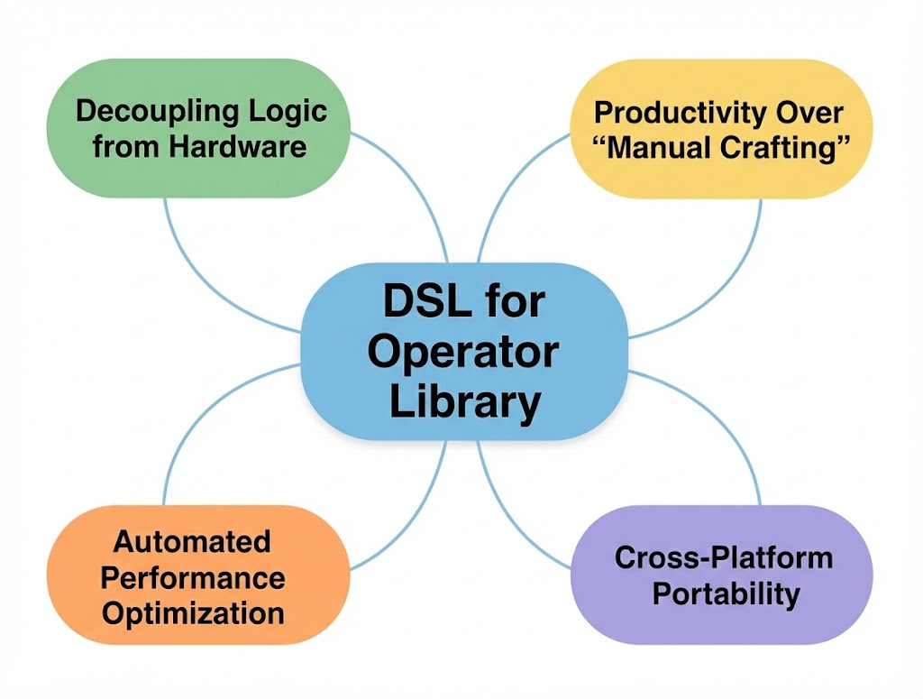
Use DSL to Implement Operator Libraries
Developers describe “what to do,” while the compiler determines “how to do it.”
A total separation between operator logic and physical implementation
Core Objective: Make operator development simpler and more efficient while ensuring cross-platform portability
Examples: Triton, TileLang, Gluon
https://zhuanlan.zhihu.com/p/1977691609266161545

Slide 13
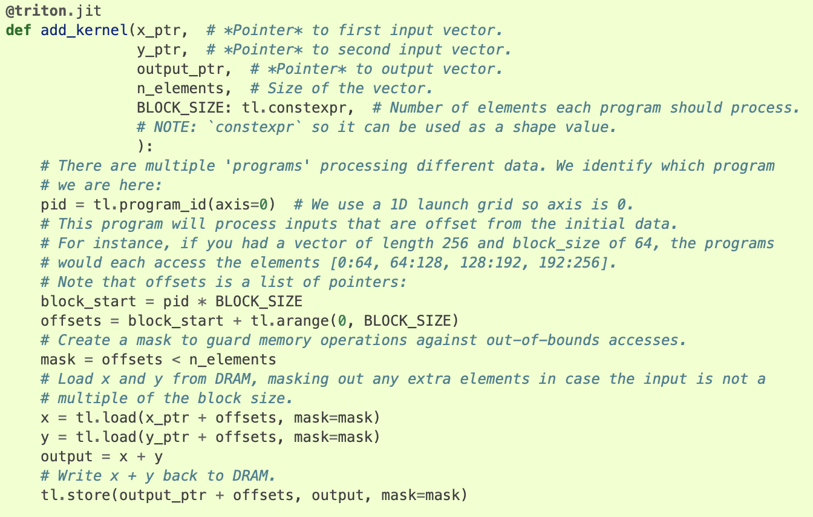

DSL for Operator Library - Triton
Python-Based Tile Programming
Compiler-Driven Optimization
Hardware-Agnostic Abstraction
https://triton-lang.org/main/getting-started/tutorials/01-vector-add.html

Slide 14
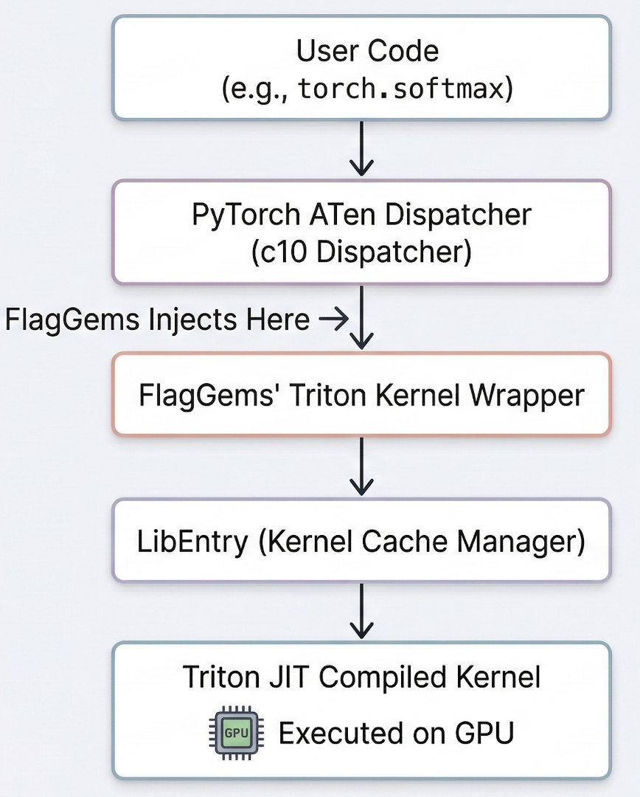
Case Study: FlagGems
Transparent ATen dispatcher injection
CUDA-to-Triton kernel replacement
Zero user code modification

Slide 15
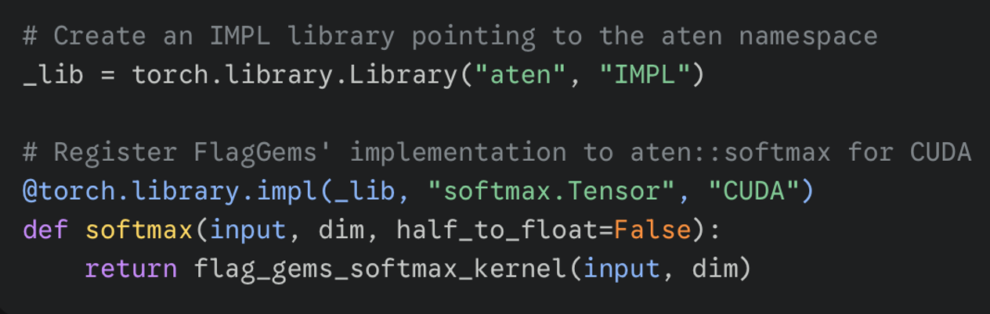
Operator Injection
"IMPL" mode override execution
Existing ATen operator interception
Specific dispatch key routing

Slide 16
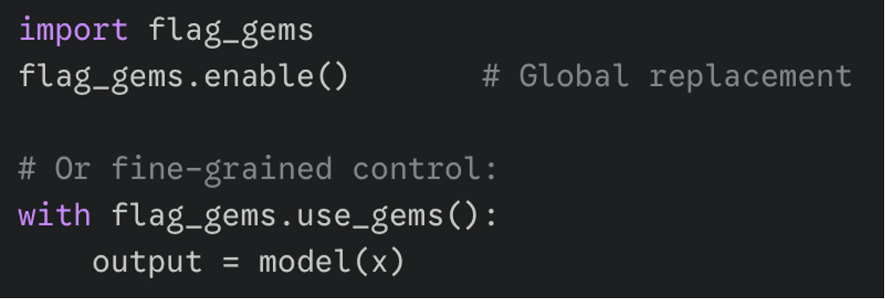
Global and Contextual Replacement
FlagGems maintains an operator registry.
enable(): Traverses the registry and registers operators.
use_gems(): Context manager for fine-grained operator replacement control.

Slide 17
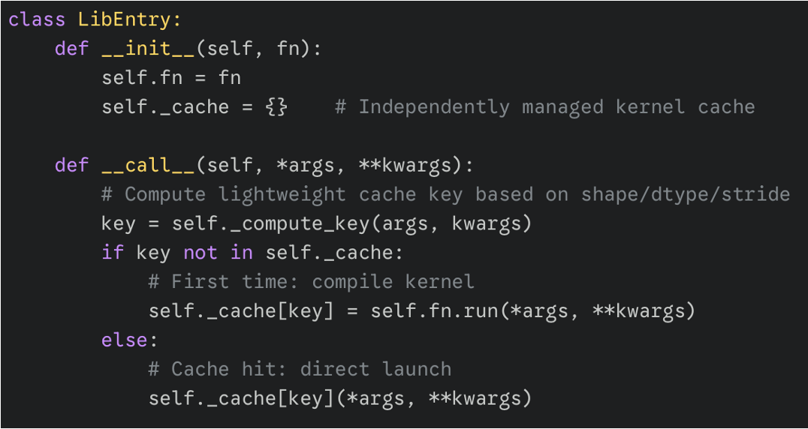
LibEntry: Kernel Cache Manager
Native Triton runtime bypass
Independent kernel cache management
Lightweight cache key computation
Near-zero subsequent Python overhead

Slide 18
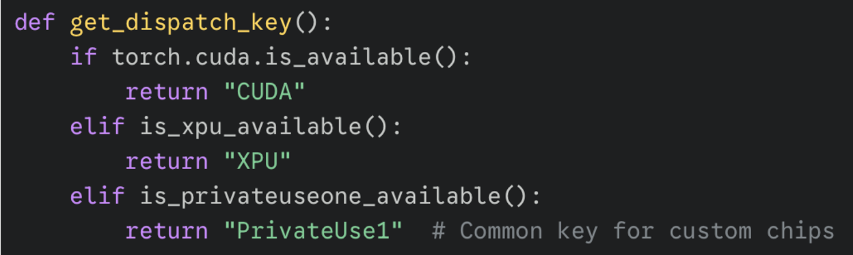
Multi-Hardware Dispatch Strategy
Dynamic runtime environment detection
Hardware-specific dispatch key routing
Unified Triton codebase execution

Slide 19
Takeaways
API Transparency
Native framework APIs remain completely unchanged while transparently routing to optimized kernels.
Hardware Decoupling
Utilizing dynamic dispatch keys provides a unified, scalable path for supporting diverse backend chips.
Execution Overhead
Custom cache managers like LibEntry bypass native runtimes to nearly eliminate Python dispatch delays.
Kernel Generation
Dynamic decorators present a streamlined approach for automatically generating and tuning fused operations
Notes:
单击此处添加文本

Slide 20
References
flagos-ai/FlagGems
Triton documentation
NVIDIA cuDNN Documentation
Let's talk about the PyTorch dispatcher : ezyang's blog

Slide 21
Lecture 18：Module II Final Project (RMSNorm + Residual Fused Operator)

Slide 22
Course Projects Overview
Lecture | Project Name | Type | Key Assessment Criteria
5 | Environment Setup and Toolchain | Lab Session | Four-Phase Operational Verification + + Lab Report
9 | Softmax Kernel (Midterm) | Individual Project | Correctness 40pts + Performance70% Threshold
18 | RMSNorm+Residual Fusion (Final) | Individual Project | Performance must reach FlagGems Benchmark 90%
27 | FlagTree Pass Contribution (Final) | Individual Project | Choose from 3 directions, FileCheck Test Verification
36 | 7B Multi-Node Distributed Training (Final) | 3-Person Team | Comparison of 3 Parallelism Strategies + + Linear Speedup Ratio
46-47 | Capstone Project Defense | Group Defense | Proposal Feasibility + + Authenticity of Progress

Slide 23
Project Overview
Project Background
RMSNorm（Root Mean Square Normalization) and Residual Connection (Residual Connection) are core components of modern large language models (e.g., the LLaMA series). Fusing both into a single Kernel can significantly reduce HBM accesses, a classic operator fusion scenario. Students must implement a high-performance fused operator, with performance target of reaching FlagGems of the 90% benchmark implementation or above.
Project Objectives
Using Triton to implement Add + RMSNorm Fused Kernel, supporting float32 and bfloat16
Support arbitrary [M, N] input (N is the normalization dimension, typical values: 4096/8192）
Correctness: maximum absolute error vs. PyTorch step-by-step computation < 2e-5（float32）
Performance: on target shape [4096, 4096] achieve FlagGems of the reference implementation throughput 90%
(Advanced) Support backward pass Kernel (gradient computation)

Slide 24
Implementation Requirements
Forward Operator Specification
Key Optimization Points
Single Kernel completes addition and normalization with only one HBM read/write HBM
Use Triton 's tl.rsqrt to compute RMS
Handle N misalignment with Mask loading
For bfloat16, accumulate internally in float32 before conversion (precision guarantee)
Performance Analysis Report (Must Include)
Nsight Compute 's Roofline Analysis Chart: showing the operator's Arithmetic Intensity
Throughput comparison across different BLOCK_SIZE（64/128/256
overhead comparison with non-fused (step-by-step) implementation Kernel Launch
def fused_add_rms_norm(x, residual, weight, eps=1e-6):
# x, residual: [M, N] weight: [N]
# Returns (normed_output, updated_residual)

Slide 25
Submission Requirements and Grading Criteria
Submission Checklist
fused_rms_norm.py: complete Kernel code with correctness tests
benchmark.py: reproducible performance benchmark script
report.pdf: no more than 6 pages, including design decisions, NSC analysis results, and performance comparison charts
(Advanced) grad_kernel.py: backward pass implementation and gradient verification code
Grading Criteria
Assessment Dimension | Score | Grading Criteria
Code Correctness (float32/bf16） | 30 pts | Both data types pass precision verification
Performance (Throughput) | 30 pts | ≥90% benchmark for full score; 75%-90% scores 20 pts
Optimization Analysis Report | 25 pts | Roofline chart, Block Size analysis, fusion gain quantification
Code Engineering Quality | 10 pts | Complete comments, clear interfaces, no hard-coding
Advanced: Backward Pass | 5 pts | Correct gradients with numerical verification

Slide 26

The Solution: FlagOS, a Unified AI Software Stack

Slide 27








https://space.bilibili.com/3546791834290849
https://github.com/flagos-ai
https://www.zhihu.com/people/95-22-20-18/posts
https://flagos.io/Home

Slide 28

Thanks for your time！

